Slide 1
A Visual filter for The Learning Registry
Jim Klo (jim.klo@SRI.Com)
SRI International

Slide 2
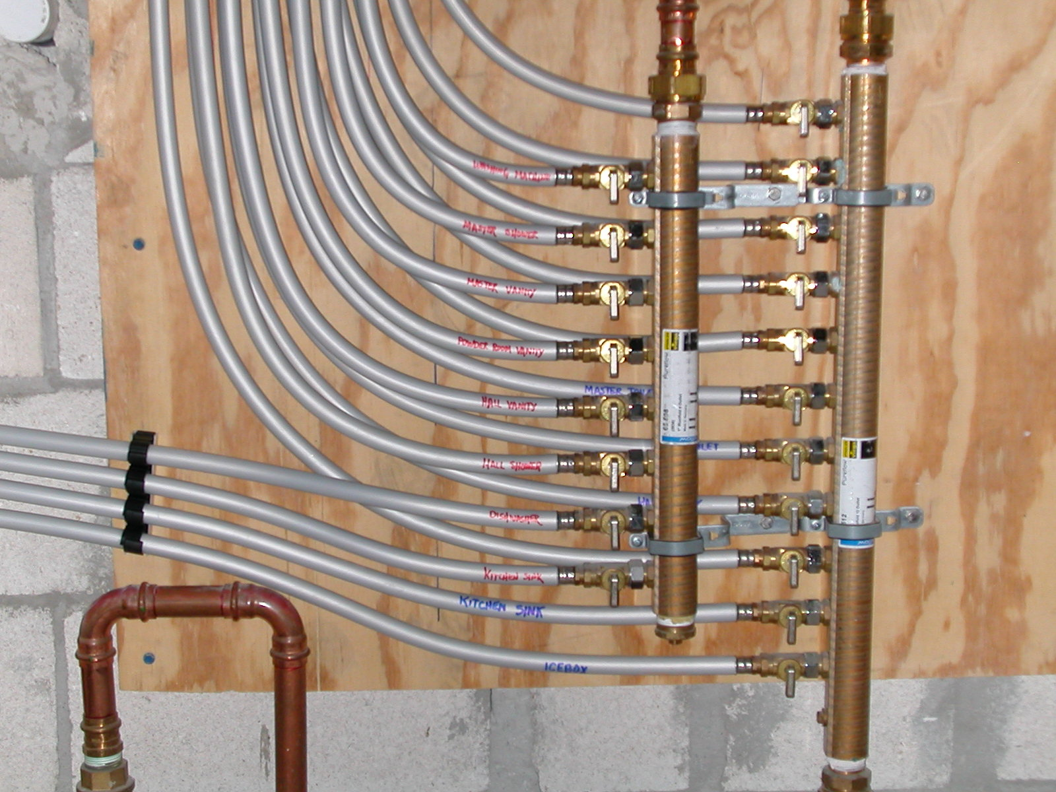
We can all share
Notes:
Learning Registry is a data network for advertising metadata and activity data (paradata) on a data network that connects disparate repositories together. Any format, any schema, linked or inline, it’s welcome.

Slide 3

Open mic night all the time
Notes:
We do mean anything by anyone. Metadata, usage data (which we call paradata), service data, anything you can think of and really any format you want. From the largest repository to an individual educator.

Slide 4

A Needle in a Haystack
Notes:
Now that we have all this raw data. We have a lot of it. How do we find and focus on things we need. Early adopters have been asking this question for some time.
The intent of the LR is to be an infrastructure. The only services we offer are JSON RPC and OAI-PMH endpoints for publishing and harvesting.
We currently don’t have a good way to communicate how such a system could work as the infrastructure definitions are hard to understand.
The LR is lacking such a communication device to help inspire innovation to leverage this infrastructure.

Slide 5
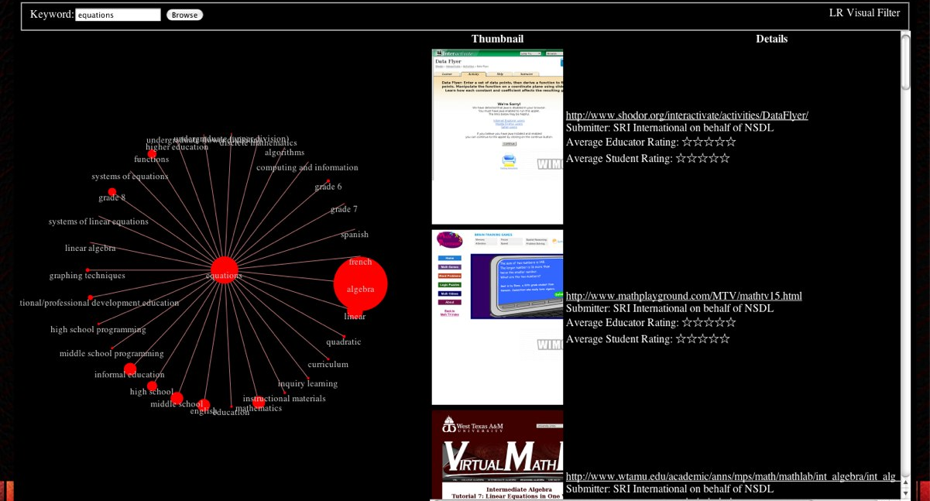

A Visual Approach
Welcome, Ed Cator
Comments: 25 view add
Comments: 36 view add
Notes:
Since the Learning Registry is devoid schema standards, parsing all is not appropriate.
Paradata formats are more limited – we can drive an implementation to parse a few.
This is an HTML 5 approach, which makes the solution more device agnostic.

Slide 6


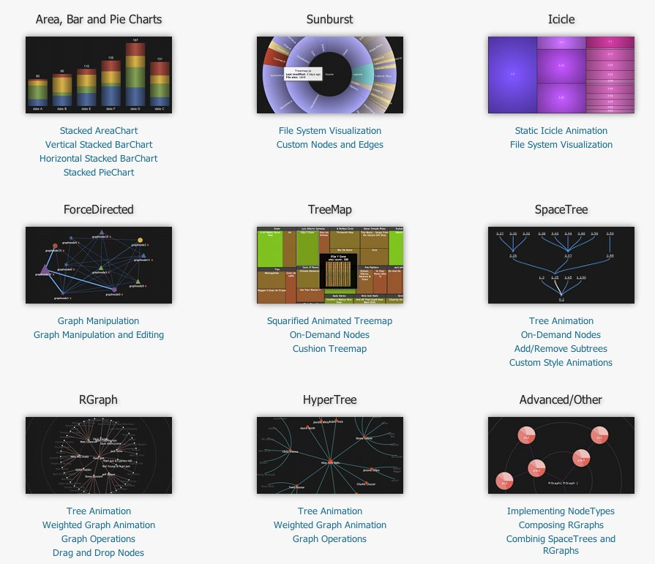
Multiple Options
Thumbnail Service:
W<IMG
http://wimg.ca
HTML5 Graphs:
JavaScript InfoVis Toolkit
http://thejit.org
Notes:
The demo uses a HTML 5 canvas visualization toolkit that is multi-device compatible
Leveraging a free on demand thumbnail service for screen shots.

